Slide 1
Candy Calculator
By: Pranav Dadu, Yojith Mandapati, Thien Nguyen, Kegan Edwards, Ninh Nguyen

Slide 2
Introduction: What candy should you try next?
269 thousand votes were collected from 8,371 different IP addresses
chocolate: Does it contain chocolate?
fruity: Is it fruit flavored?
caramel: Is there caramel in the candy?
peanutalmondy: Does it contain peanuts, peanut butter or almonds?
nougat: Does it contain nougat?
crispedricewafer: Does it contain crisped rice, wafers, or a cookie component?
hard: Is it a hard candy?
bar: Is it a candy bar?
pluribus: Is it one of many candies in a bag or box?
sugarpercent: The percentile of sugar it falls under within the data set.
pricepercent: The unit price percentile compared to the rest of the set.

Slide 3
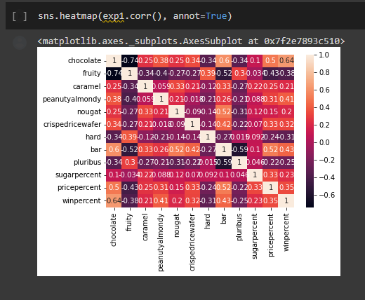
(2) discuss your methods (including any pre-processing and modeling),
*correlations? What do they mean do they
Matter?
Notes:
Questions are rhetorical

Slide 4
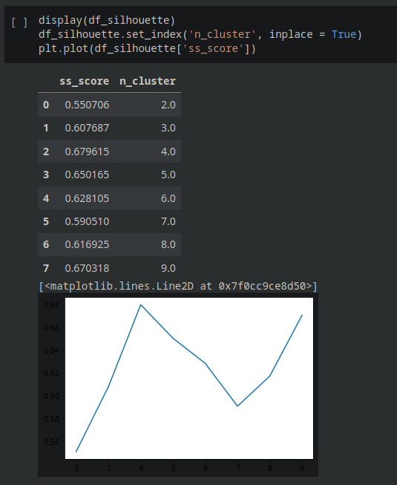
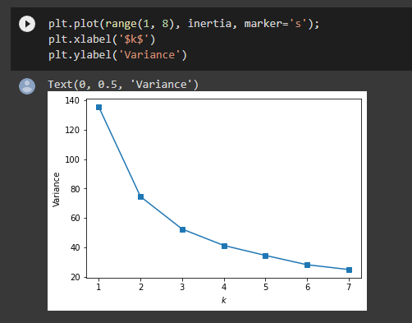
Elbow PCA
What do the clusters mean?

Slide 5
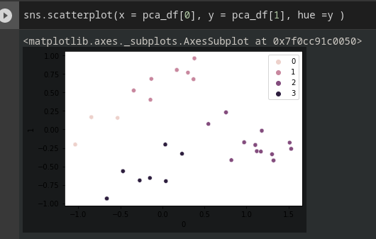
PCA
What do these mean?

Slide 6
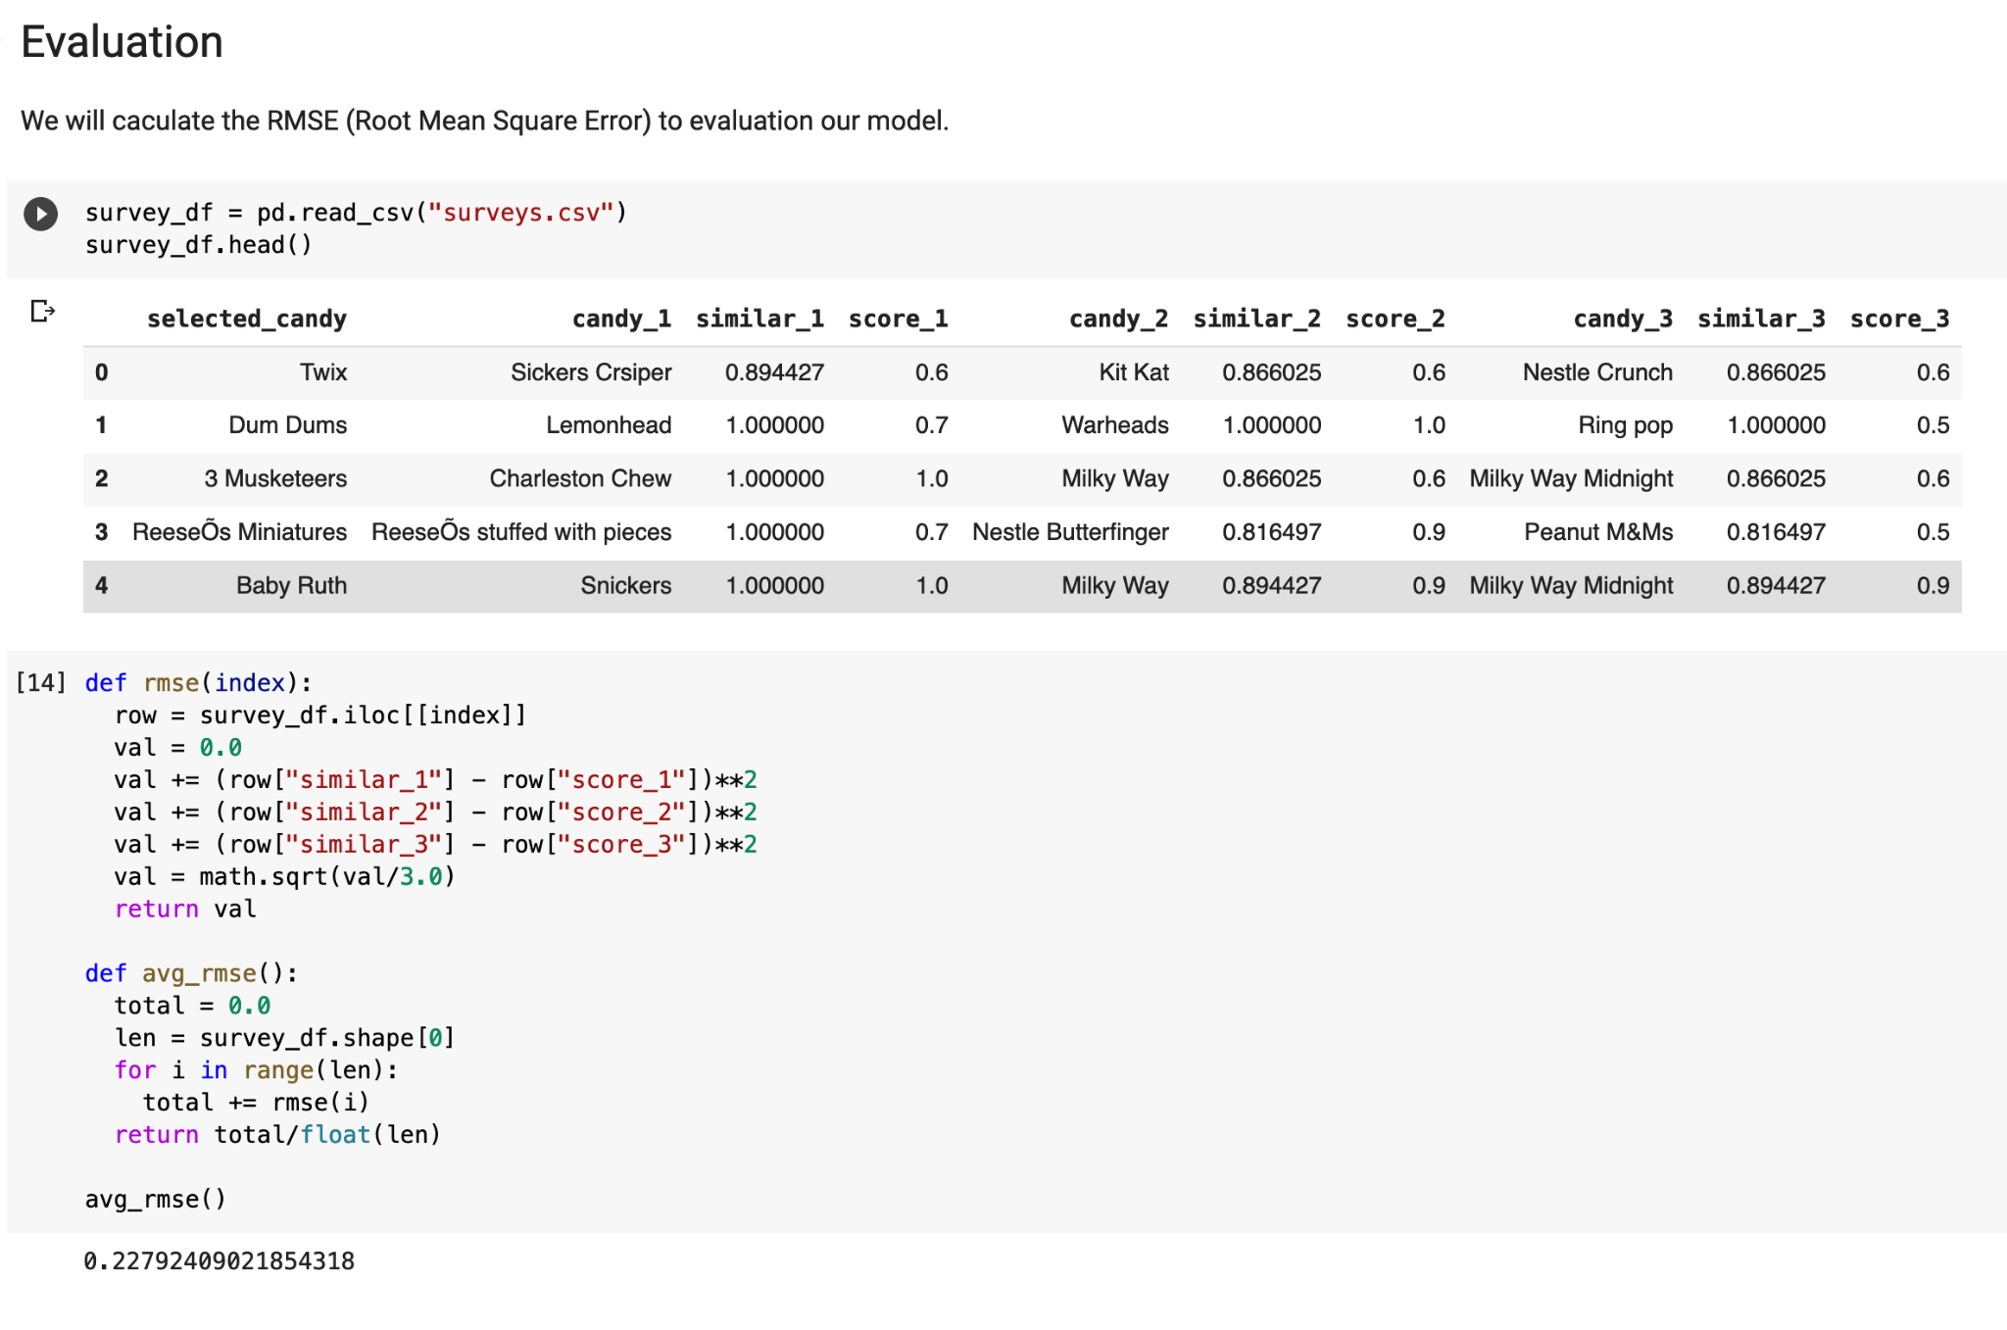
Results
Participants:
6 : (
Method:
Subjective rating of how accurate
The candy was from 0 to 1
Evaluation:
Rmse: ~22.8% (not great?)
Notes:
Kegan Slide

Slide 7
Things We Learned (??!)
Lots of candies are very similar on paper, but different in reality -> experiential things are hard to quantity? How much of that experiential difference is a result of expectations from branding?

Slide 8
Impact on Society
Negative
Sugar rush for Kids
Positive
Recommend similar candy
Tourists and cuisine
Health Awareness
Patent infringement (maybe)
Notes:
Yojith got this

